Slide 1
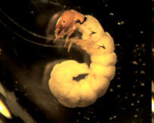
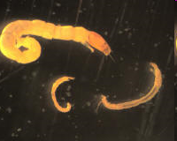
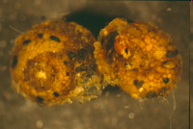
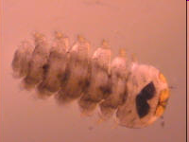
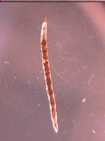
Stream macroinvertebrate responses to landscape variables; an evaluation of rapid bioassessment techniques using a statistical modeling approach.
Declan J. McCabe¹ and Philip A. Yates²
Saint Michael’s College Biology
Saint Michael’s College Mathematics

Slide 2
Acknowledgements
This work could not have been done without the help of Kaitlyn Berry; Alex Canepa; Tyler Gillingham; Erin Hayes-Pontius; Bridget Levine; Lexie Haselton
Work made possible by funding from Vermont EPSCoR with additional support from Saint Michael’s College

Slide 3
Stream Macroinvertebrate biomonitoring at Saint Michael’s College
Ongoing since 2008
60+ site database
Modeling watershed effects on invertebrate communities
Our focus today – 53 sites; modeling project

Slide 4
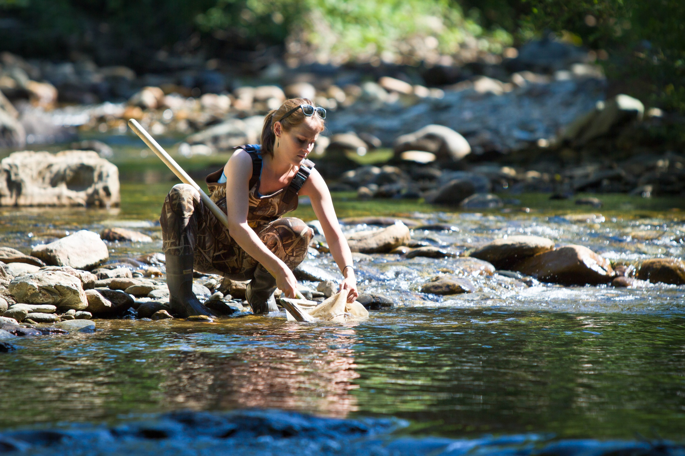
Sampling
Each stream:
4 kick net samples
Identification by trained interns
Standard keys
Iphone app

Slide 5
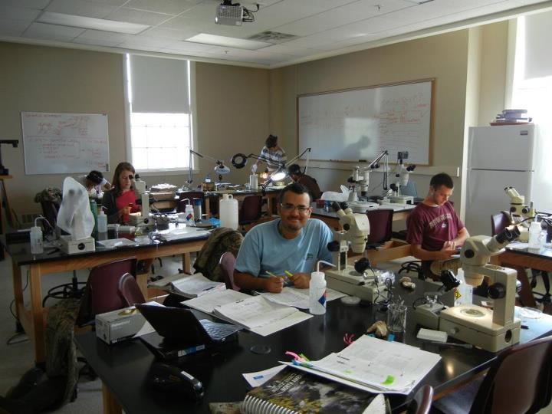
Samples serve many purposes
Primary research questions
Intern presentations (ASLO; LCRC; SACNAS etc.)
High school outreach support

Slide 6
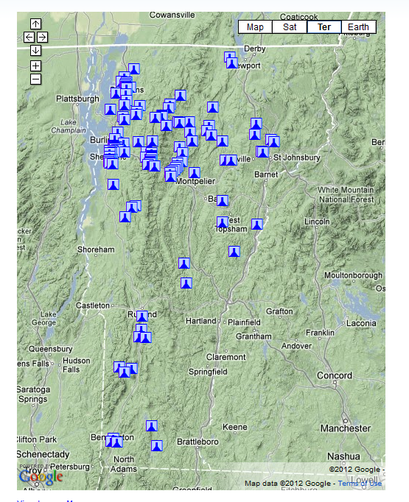
Landscape data
GIS-derived watershed characterization
Reclassified 2006 C-CAP (Costal Change Analysis Program) land coverage data
Macroinvertebrate samples from 2008 through 2010 used to characterize streams along an urban/forested gradient

Slide 7
Landscape parameters
Catchment Area Acres
Agricultural Acres
Percent Catchment Agricultural
Urban Acres
Percent Catchment Urban
Forested Acres
Percent Catchment Forested
Upstream Distance Lake Pond (m)
Upstream Distance Dam (m)
Upstream Distance Bridge (m)
Upstream Distance Culvert (m)
Distance To Tributary Mouth (m)
Percent Catchment Highly Erodible Soils
Stream Order
E911 Structure Count
E911 Structures per Acre
E911 New 2008
Stream Gradient for 100m Stream Segment
Aspect for 100m Stream Segment Buffer
Sinuosity
Dominant Bedrock Class
Average Catchment Area Elevation (m)
Monitoring Site Elevation (ft)
Length Road Network in Catchment (km)
Length Road Network in Catchment (m)
Length Road Network Gravel (km)
Length Road Network Gravel (m)

Slide 8
Parameters in our generalized additive models
Catchment Area Acres
Forest principal component
Agricultural component
Upstream Distance Lake Pond (m)
Upstream Distance Dam (m)
Upstream Distance Bridge (m)
Upstream Distance Culvert (m)
Distance to Tributary Mouth (m)
Stream Gradient for 100m Stream Segment
Aspect for 100m Stream Segment Buffer
Sinuosity
Dominant Bedrock Class

Slide 9
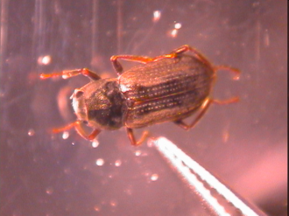
Macroinvertebrate responses
EPA’s 14 candidate benthic metrics for measuring effects of perturbation (Barbour et al 1999):
Vermont Departmental of Environmental Conservation biocriteria (2004)
Merritt, Cummins, and Berg (2008)

Slide 10
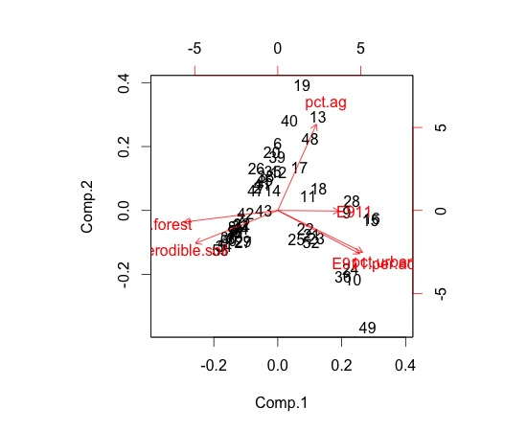
Model details
Principal components analysis used to generate a landscape axis that best explained each macroinvertebrate response variable

Slide 11
Model details
GIS data used to predict occurrence of each species along the PCA axis based on a binary distribution
The predicted species present data are summed to yield a predicted community
Standard metrics can be measured from the predicted community and compared to observed

Slide 12
Example

Slide 13
Which index best responds?
Metrics yielding models with the tightest fit:
% filterers; % Ephemeroptera; % grazers; % clingers
Metrics specifically responding to land use:
Forested land increased % EPT & % Ephemeroptera
Agricultural land increases % filterers & % clingers
Metrics that could not be modeled:
Plecoptera richness; Trichoptera richness; # of intolerant taxa

Slide 14
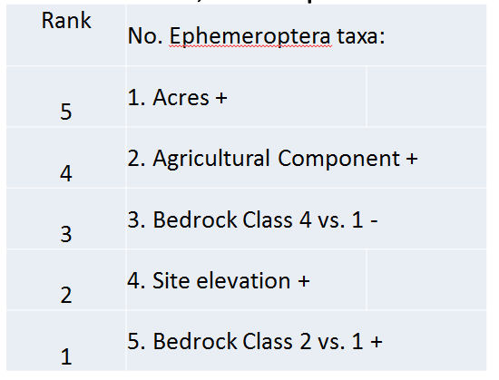
What landscape parameters were most influential?
We ranked the factors influencing each response variable; Example:

Slide 15
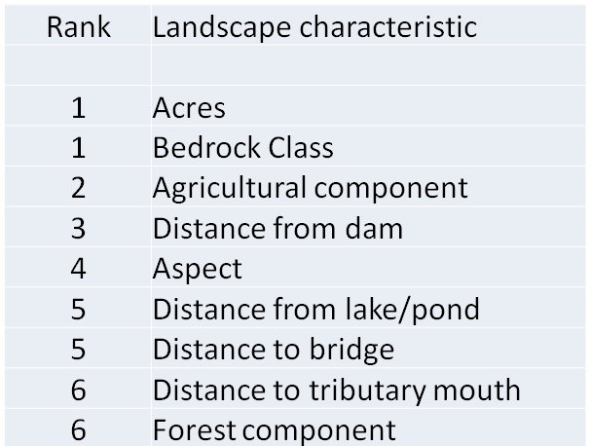
What landscape parameters were most influential?
We summed the ranks to find the characteristics that had the largest influence on the most benthic metrics:

Slide 16
Next steps
Test the models using 6 new sites ranging in land use
Questions?

